Slide 1

@SharePointCincy
#SharePointCincy
Welcome to
Building Single Page Applications in SharePoint using AngularJS
Speaker: Steve Pietrek (@spietrek)
References:
https://github.com/spietrek/SharePointCincy2015
https://github.com/spietrek/Cardinal.Projects
http://jsfiddle.net/spietrek/VKbpu/3/
https://jsfiddle.net/spietrek/04y3zwo8/2/

Slide 2


@SharePointCincy
#SharePointCincy
Conference Hosts

Slide 3










@SharePointCincy
#SharePointCincy
Please visit the sponsors and thank them. Without them, we wouldn’t have a conference!
PLATINUM SPONSOR
EXHIBITORS
GOLD SPONSORS

Slide 4



@SharePointCincy
#SharePointCincy
 | Open wireless access is available.
 | See something remarkable? Tweet (#SharePointCincy) and share it during the session!
 | Facebook User? Post your comments to our new Facebook Group Page. Just look for SharePoint Cincy.
Notes:
Twitter

Slide 5
Agenda
SPA Overview
AngularJS Overview
SharePoint Development Challenges
SharePoint Data Access
Tools
Projects Demo
Deployment
Best Practices & Gotchas

Slide 6
Single Page Applications

Slide 7
Single Page Applications
Goal:
Provide a desktop-like rich user experience
Attributes:
Entire site content loads within a single HTML page
Only areas of the site will reload based on user actions. No URL change except for hash (#).
State maintained on client
Presentation layer can be completely decoupled from backend layer
Main technologies: HTML, CSS, JavaScript, AJAX, web services (e.g. REST)
Benefits:
Performance
Maintainability (if you leverage a framework)
Code reuse
Team-friendly

Slide 8
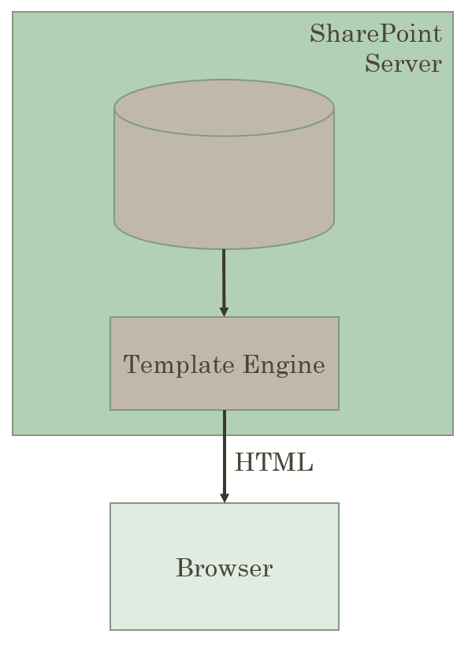
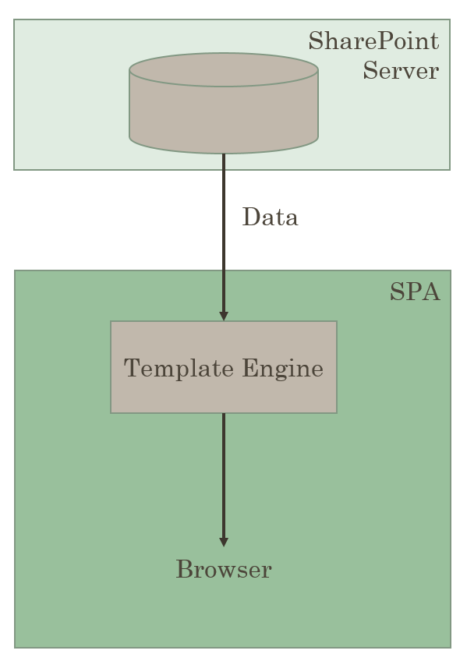
Traditional vs. Single Page Application

Slide 9
AngularJS Overview

Slide 10
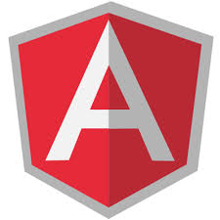
What's AngularJS?
"Superheroic JavaScript MVW Framework"
Structural JavaScript client-side framework for building dynamic web apps (using HTML and JavaScript)
Empowers traditional HTML
Extend HTML's syntax to express your application's components clearly and succinctly
Backed by Google and the community
Open source (MIT License)
Vibrant community (books, blogs, plug-ins, resources, etc.)
** Great framework for building single page applications
** My opinion

Slide 11
AngularJS Main Features
Backed by Google & Community
MV*
Dependency Injection
Testing
jqLite
Templates
Modules
Controllers
Filters
Providers
Form Validation
Routing
Two-way Data Binding
Directives
Great for SPA’s

Slide 12
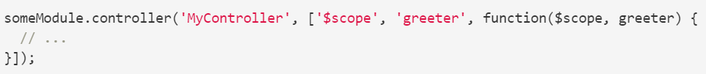
Dependency Injection
Design pattern in which an object is given its dependencies, rather than the object creating them itself
Separate the process of creation and consumption of dependencies
Provides an easy way to change dependencies if needed
Key to making easily testable components (i.e. mock objects)
Important: Use Inline Array String Annotation or $inject (required to minify code)

Slide 13
Modules
Organize your code – similar to .NET namespaces
Code is more maintainable, testable, and readable
Create modules for dependencies using DI
Includes multiple Controllers, Filters, Directives, and Providers
Module
Config
Controllers
Filters
Directives
Routes
Factories
Services
Providers
Values
Constants

Slide 14
ng-app
Root element for an AngularJS app
Directive to bootstrap an Angular application
<html ng-app="app">
Only one ng-app per page
Need more than one … manually bootstrap
angular.bootstrap(document.body, ['app']);

Slide 15
Scope
Scope
View
Controller
Data models which are POJO's
Glue between an application controller and the view
Scopes can watch expressions and propagate events
Expressions
<h5>Search Term: {{demo.name}}</h5>
Watches are used to watch for scope changes:
$scope.$watch("firstName", function(value) {
//do something with value…
});

Slide 16
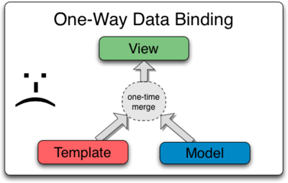
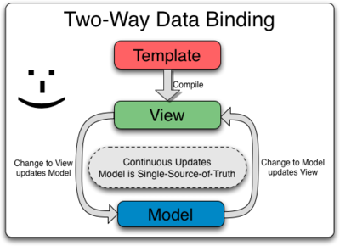
Data Binding
Create complex objects.
Bind in one direction (merge).
Change to Model is not updated in View (and vice versa).
Additional code is required to keep Model and View in sync.
Use POJO’s.
Template is compiled into a “live view”.
Changes to View or Model are kept in sync.
The “glue” is $scope.

Slide 17
Controllers
Use to:
Set the initial state of scope (i.e. Scope Container)
Add logic/behaviors to the scope object
Add logic/behaviors to update the scope based on user interaction
Follow Single Responsibility Principle (SRP) to aid in testing
Do not use to:
Manipulate the DOM. Use data binding or directives.
Communicate between controllers. Use services.
Filter objects. Use filters.

Slide 18
AngularJS Implementation of MVC
Controller
User Interaction
Controller
Model
RESTful Web Service
DOM
View
** Diagram from Pro AngularJS

Slide 19
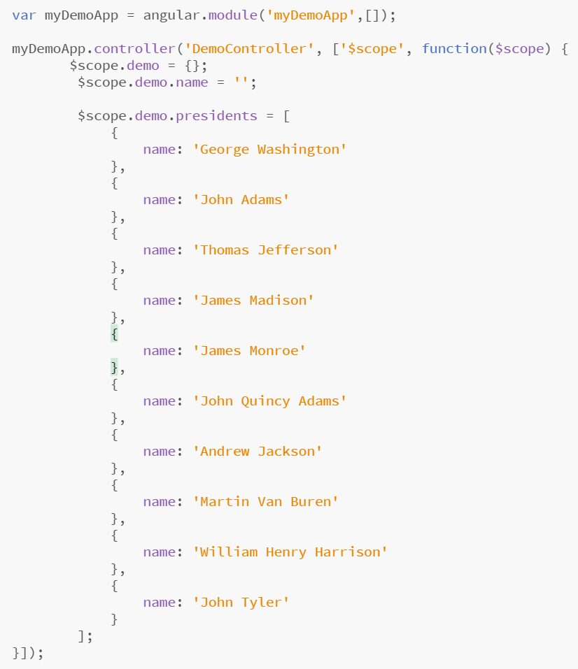
Controllers
Controller
Module
Dependency Injection
Scope

Slide 20
Filters
Formats the value of an expression displayed to users
OOTB examples include:
currency, date, filter, json, limitTo, lowercase, number, orderBy, uppercase
Chain multiple filters using |
Create custom ones as well
ng-repeat="president in demo.presidents | orderBy:'name'"
ng-repeat="president in demo.presidents | filter:demo.name"
<li ng-repeat="president in demo.presidents | orderBy:'name' | filter:demo.name">
{{president.name | uppercase}}
</li>

Slide 21
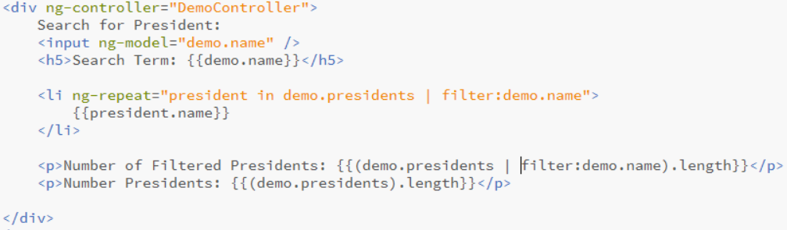
Pulling things together
Controller
Directive
Directive
Filter
Scope
Directive
Scope
Expression
Expression
Scope
Expression
Expression
Scope
Filter

Slide 22
AngularJS Demo https://jsfiddle.net/spietrek/VKbpu/3/ https://jsfiddle.net/spietrek/04y3zwo8/2/

Slide 23
Providers
Singleton objects
Keep data around for lifetime of application
Separation of concerns
Logical place to access external data ($http or $resource)
Preferred method to communicate between controllers
Constant
Value injected anywhere
Value
Simple injectable value
Factory
Injectable function
Service
Injectable constructor
Provider
Configurable factory
Notes:
http://blog.xebia.com/2013/09/01/differences-between-providers-in-angularjs/

Slide 24
Directives
Many out-of-box directives (e.g. ng-app, ng-repeat, ng-model, ng-controller, etc.)
Allow you to extend HTML vocabulary for your application
HTML annotations that trigger JavaScript behaviors
Extend attributes, elements, classes, or comments
Function that runs when the compiler encounters it in DOM
DISCLOSURE: Most complex area in AngularJS. Important to learn for code reuse and separation of concerns.

Slide 25
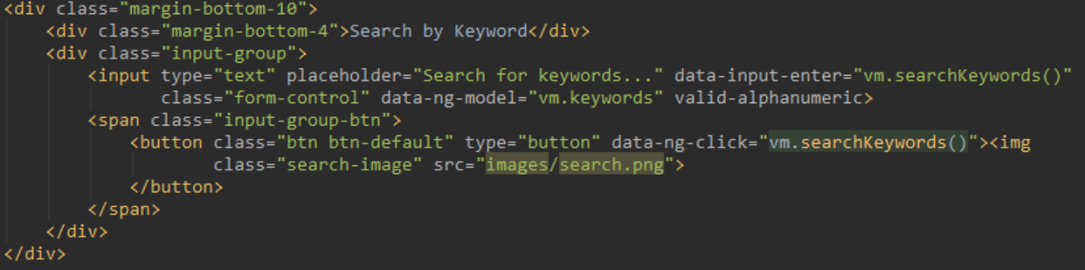
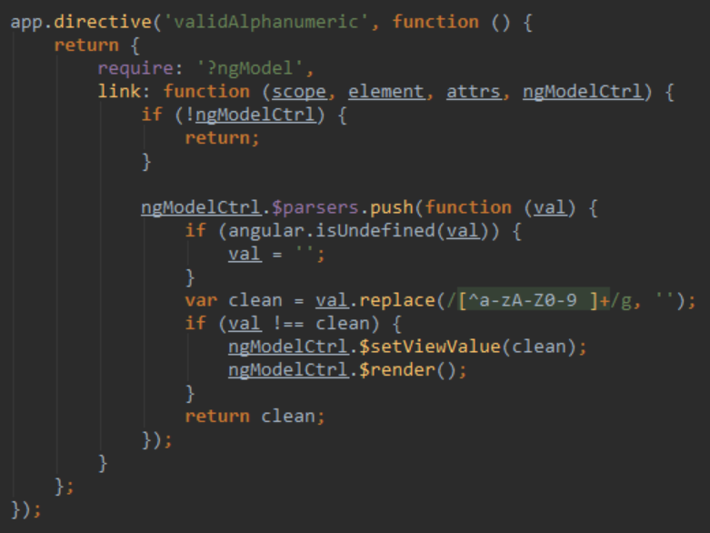
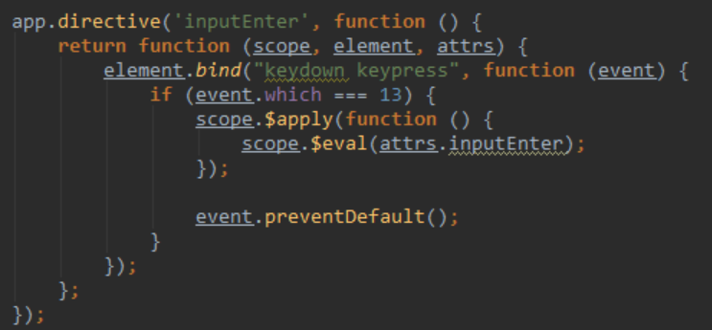

Slide 26
SharePoint Development Challenges

Slide 27
SharePoint 2007 Challenge
Full Trust applications
Code affects the whole farm
Developers build custom solutions
Administrators can only secure solutions with Code Access Security (CAS)
Hard to control what is in custom code (e.g. Elevated Privileges)
Biggest cause of SharePoint support cases: Custom code
Developer
Administrator
Site Collection Owner
Activate and use customizations
Design, build, and test customizations
Install and monitor customizations

Slide 28
SharePoint 2010 Challenge
Developer
Administrator
Site Collection Owner
Install customizations
Design, build, and test customizations
Set quotas and monitor customizations
Activate and use customizations
Sandbox solutions applications
Code affects the site collection
Developers build custom solutions
Administrators define quotas and use resource monitors to check site collection usage
Site collection owners deploy, activate, and implement the customizations
Missing functionality in Sandbox Solutions

Slide 29
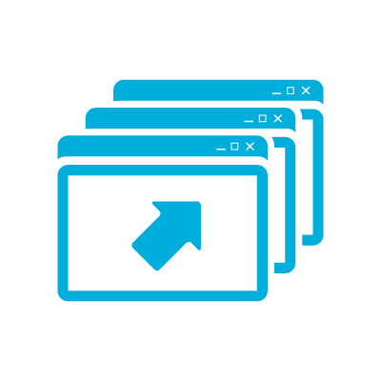
SharePoint Development Challenges
Performance and Stability
Lifecycle Management
Not Cloud Ready
Resources
Notes:
Challenges
Difficultly finding qualified resources
Steep learning curve
Performance and stability issues
Requires deployment by Farm Administrators
Lifecycle management
Not cloud ready
What is a SharePoint 2013 App?
Web application that runs “OUTSIDE” of SharePoint
Uses Client OM to talk to SharePoint (JS, REST/CSOM)
Is the future proof way to add new capabilities to SP2013+
Is available from the Corporate App Catalog or SharePoint Store
Is easy to install by site owners or Tenant/Farm administrators

Slide 30
Benefits of SharePoint 2013 App Model
Infrastructure
Developers
Users
Isolation & multitenant
Reduces risk to farm
Simplifies SharePoint upgrades
Cloud ready
Corporate App Catalog facilitates governance
Larger developer reach
Use industry standards
Use non-SharePoint technologies
Lifecycle management (development, deployment, versioning, upgrades)
Based on familiar app model
Apps can be downloaded from SharePoint Store or Corporate App Catalog
Notes:
Challenges
Difficultly finding qualified resources
Steep learning curve
Performance and stability issues
Requires deployment by Farm Administrators
Lifecycle management
Not cloud ready
What is a SharePoint 2013 App?
Web application that runs “OUTSIDE” of SharePoint
Uses Client OM to talk to SharePoint (JS, REST/CSOM)
Is the future proof way to add new capabilities to SP2013+
Is available from the Corporate App Catalog or SharePoint Store
Is easy to install by site owners or Tenant/Farm administrators

Slide 31
Why not use the SharePoint 2013 App Model?
JavaScript provides a "quicker" development experience
Leverage other IDE's such as WebStorm
Configuring the on-premise App Store can be painful
Deploy to a site without permission access to App Store
App parts run as iframe which doesn't scroll in iOS

Slide 32
SharePoint Data Access

Slide 33
SharePoint 2013 Remote API
SharePoint
_api is new alias for _vti_bin/client.svc
Server
Client
REST
OData
(2013)
CSOM
Data Access
JavaScript Library
Silverlight Library
.NET CLR Library
OAuth
Cross-domain Library
Authentication
Remote App
Note: ASMX web services have been deprecated
Notes:
Remote APIs are now a first-class citizen
Search, MMS, User Profile, BCS, et al
User-centric capabilities (no Central Admin-like support)
Client-side object model (CSOM)
REST-based (OData)
OAuth provides an open protocol that enables secure authorization in a simple and standard way.
The cross-domain library is a client-side alternative that lets your app communicate with SharePoint installations in the same internet zone.
Changes from SharePoint 2010
The client.svc service extended with REST capabilities
Allows the ability for SharePoint to be accessible from many devices
client.svc now supports direct access from REST clients
client.svc accepts HTTP GET, PUT, POST requests
Implemented in accordance with OData protocol (OData Spec != SharePoint REST)
Many new API’s
CSOM Extended new APIs
New APIs for SharePoint Server functionality
SharePoint 2013 REST
OData standards
Simple and Easy to Use
Much easier to use than SOAP-based Web service or CSOM
Higher productivity when using JavaScript and jQuery
Test in a browser
Platform agnostic
Better documentation
Each query is submitted with a unique URL
Results can be cached by proxy servers
Chattier than CSOM
SharePoint 2013 CSOM
Collection of libraries that acts as a proxy to the server-side object model
Accessible through client.svc
Calls to client.svc must go through supported entry points (.NET, Silverlight, JavaScript)
Provides more functionality than REST (i.e. filtering on nulls)
Greater learning curve (i.e. CAML queries)

Slide 34
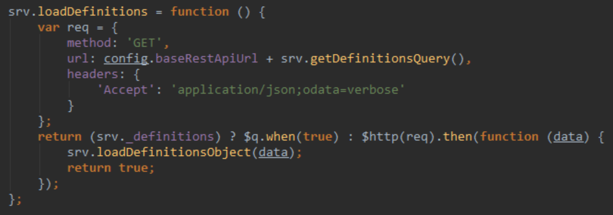
SharePoint 2013 REST
Use jQuery AJAX or AngularJS $http
Best practices
Use Postman or Fiddler to execute, test, and review queries
Set the Accept header
Only retrieve what you need. Use $select and $filter.
“Chunky, not chatty”

Slide 35
Tools

Slide 36
Tools
IDE: Visual Studio, WebStorm, Brackets, Atom, Sublime Text
Third-party JavaScript frameworks: jQuery, Bootstrap, Moment, DataTables, ng-tasty, Font Awesome, SPServices, lodash
Browser Plug-ins: Firebug, Batarang, Postman
Task Runners: Gulp, Grunt
Package Managers: npm, Bower
Source control: Git, Visual Studio Online
Other tools: Node.js, Fiddler, Karma, Jasmine, PhantomJS

Slide 37
Projects Demo

Slide 38
Deployment

Slide 39
Deployment Workflow
Create Custom Page Layout
Upload Source Code to Pages library
Style and script references
Base HTML referencing ng-app
Same folder structure as local environment
Upload source code
SharePoint Deployment & Test
Enable Publishing features
Upload to Master Page Gallery
Update and upload custom page (if necessary)
Upload source code to Pages library
Local Test
Gulp tasks
Functional testing
Disable web security (--disable-web-security) errors in Chrome
Functional testing
Only the build files are needed
Update page layout (if needed)

Slide 40
Best Practices & Gotchas

Slide 41
Best Practices
Filter data to reduce data loads
Group by function, not component type
Name your files by function (e.g. projects, dashboard, admin)
Group all files together (module, controllers, services, directives, unit tests, end-to-end tests)
Only one controller per view. Share data between controllers using services.
Organize code: John Papa’s Angular Style Guide http://goo.gl/xljmi6
Build and deploy often!!!
Write unit tests
Test in different browsers

Slide 42
Gotchas
Issue | Workaround
SharePoint Item-limit Threshold | Split data into separate lists or libraries. Add indexes to columns where you want to filter.
SharePoint Security | Apply security at the site or list levels. If possible, avoid item-level permissions. Use Search API to aggregate across sites and lists.
CSS Overrides | SharePoint default CSS may cause style issues. Deploy to SharePoint and test using different browsers. Update CSS to run the same in local environment.
AngularJS Controller Bloat | Use directives to manipulate DOM. Data should be stored in services.
AngularJS Performance | Avoid 2000 watchers on page (may be higher in 1.3). Use Batarang to search for duplication. Use bind once for expressions which do not change.
Dependencies | Review dependencies whenever upgrading tools.
Frameworks | "Framework of the week"

Slide 43
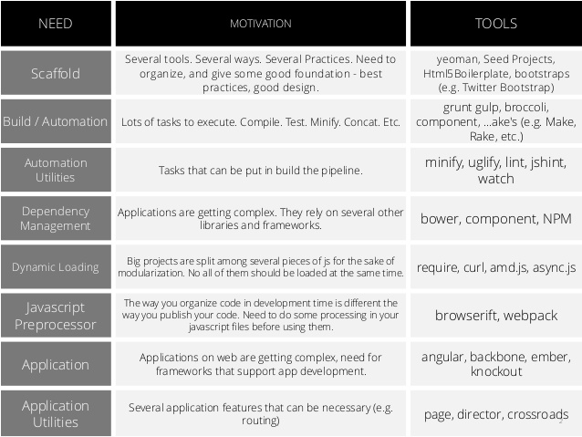
** Slide from Marcos Vinícius

Slide 44
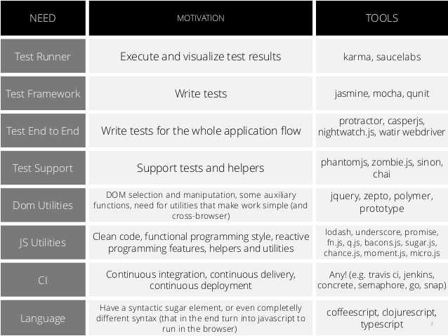
** Slide from Marcos Vinícius

Slide 45


@SharePointCincy
#SharePointCincy
 | Remember to visit the exhibit hall.
 | Get to know your user groups to find out about local activities and events in your area.

Slide 46
@SharePointCincy
#SharePointCincy
Please visit the sponsors and thank them. Without them, we wouldn’t have a conference!
PLATINUM SPONSOR
EXHIBITORS
GOLD SPONSORS

